Slide 1

2025
Sponsorship opportunities
For our valued supplier community

Slide 2








Confidence is everything
3rd October 2025
Business Design Centre London
Buyers & suppliers from all FSQS communities, together like never before
Discuss shared industry challenges
Hear from industry experts
Gain cutting-edge insights
Bring the community to life
Direct access to industry buyers
Community exclusive networking opportunities

Slide 3

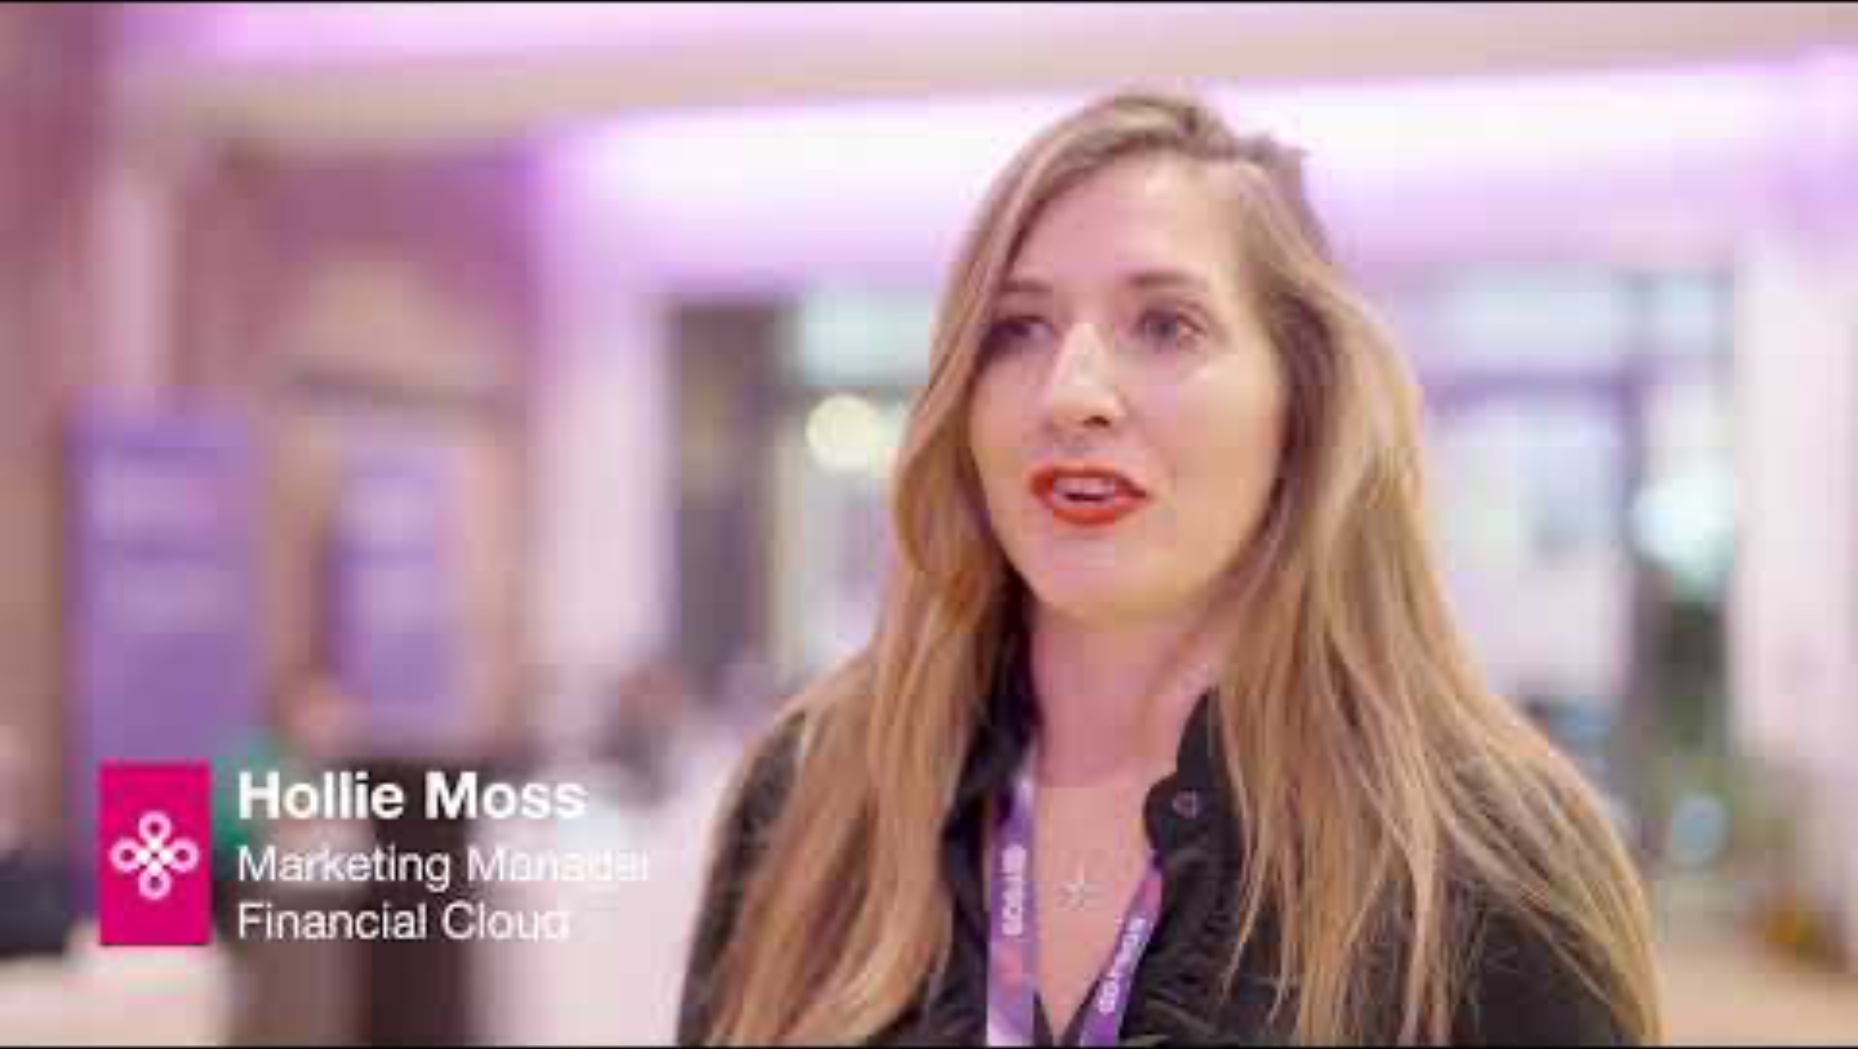

Confidence is everything

Slide 4




Meet the buyer
New for 2025!
Confidence is everything
Collaborate with confidence
Meet FSQS buyers and introduce your business
With procurement representatives relevant to what you offer
Become a step closer to building a potential relationship
Step 1
FSQS Buyers outline their areas of interest
Step 2
Request up to two 5-minute meeting slots
Step 3
If your meeting is accepted, you will be given a time slot for Meet the buyer

Slide 5





Bronze Sponsor - £7,500
Confidence is everything
Be Seen. Be Heard.
Be Remembered.
3 Available
Market stall
3 conference
tickets
Silver Sponsor - £10,000
Gold Sponsor - £15,000
Your brand on
Meet the Buyer collateral
Market stall
Panel Slot
Your brand at the Speakers' Dinner
Premium market stall
Panel Slot
2 seats at the Speakers' Dinner
Website branding
4 conference
tickets
4 seats at the Speakers' Dinner
Website branding
6 conference
tickets
For any questions or further information, please email marketing@hellios.com.

Slide 6
Amplify your brand:
Elevate your brand’s presence by being one of the select suppliers to have a market stall. This exposure will significantly boost your brand awareness within the FSQS community and beyond.
Three reasons to sponsor
Showcase thought leadership:
Gain the opportunity to position your company as an industry leader by participating in high-profile panel discussions. Share your expertise and insights with a targeted audience.
Meet the right people:
Whether it’s the speakers' dinner, Meet the Buyer or the marketplace, our buyers are there to talk to you. Be ready to explore partnerships and drive growth. Build relationships that bring you closer to collaboration.
Confidence is everything

Slide 7




“I’d recommend FSQS Live to colleagues and other companies because it’s a really strong event to meet and understand the market and what priorities should be for the next year.”
David Cass, Partner, SIA Partners
Supplier Sponsor of FSQS Live 2023
“It’s been great for us to meet and connect with people that we might not have spoken to had we not been part of FSQS.”
Hollie Moss, Marketing Manager, Financial Cloud
Supplier Sponsor of FSQS Live 2023
Hear from your peers
“Being part of the FSQS system has been great for us, it’s been a real door opener and we really enjoy being part of the community.”
David Kingston, Digital Director, Proteus
Supplier Sponsor of FSQS Live 2023
Confidence is everything
Confidence is everything

Slide 8
Package | Supplier Sponsor 3 available | Meet the Buyer Sponsor | Speakers Dinner Sponsor
Price | £7,500 | £10,000 | £15,000
TICKETS
Conference tickets | 3 | 4 | 6
MARKET STALL
Table size | 6ft | 6ft | 12ft
SPEAKING OPPORTUNITY
Panel slot | No | Yes | Yes
SPEAKERS DINNER
Tickets | 0 | 2 | 4
BRAND PROMOTION
Online promotion (website, socials, email) | No | Yes
Offline Branding | No | Meet The Buyer Branding | Dinner Branding
Package Breakdown
Confidence is everything

